Slide 1
BLEND the youth provision vision
Powered by: BLEND youth collective C.I.C

Slide 2
Who we are
We are BLEND Bude youth collective.
Set up by siblings, Jamie & Kaylie Wright in January 2016.
We host a youth space one night a week and have grown from 12 to 50+ members. We provide a social environment with a wide range of relaxed but structured activities. Attempting to empower our members by giving them ownership of the collective itself. Learning to serve each other rather than themselves. See how their money is used and what it takes to make things happen. Doing what they would like to do and not what is thought they need to do. Being there for them to gain confidence and build friendships.
All this we do in 2 hours, once a week.

Slide 3
We strongly believe that there is a massive opportunity to establish a new way of looking at youth support and developing self-perpetuating life skills for the young population of Bude. So, we have formed a C.I.C business.
BLEND youth collective is a community interest company (C.I.C) for these simple reasons:
The business primary objective is the community it supports, we do not have shareholders or owners that drive profit for their own gain.
As founders, my sister and I retain control, but have appointed a board made up of our youth members.
We can create a strong, sustainable and socially inclusive local company.
Funding for charities and community groups is harder to get and uncertain. Becoming a full-time job just applying for grants.
We will be in a position where we can make a profit and use it as capital or show funding bodies that we have been proactive in match funding.

Slide 4
WHAT WE PROPOSE
The main idea comes from the heart of the local youth.
A place full of what they want. Not only providing activities and opportunities
but giving them a purpose, a home for their ideas and imagination.
One building, incorporating six different ventures.
Milk bar & lounge
Climbing walls
Skate bowls
performing arts space
shop outlet
and the youth collective itself.
Each would support the other. Run by the collective for the development of the collective. All profits made would go back into the business and be used to grow their ideas, giving them ‘actual’ qualifications and experiences.
This would be the base element, but with the potential to provide much needed rural outreach and employment opportunities.

Slide 5
Food for thought
This would need space. A lot of space. But it is a vital provision.
A study in 2009 highlighted the facts that Bude has the highest percentage of children to population in the south west, over 18%. Over half of these are from disadvantage homes and low income families.
Blend this with the neighbourhood development plan report, that shows the towns youth provision is 63% below the national average and youth amenities are also 21% below, it makes for a worrying statistic.
With the massive influx of affordable housing developments, these figures are only set to go one way. Along with the rise in anti social behaviour orders and vandalism, which are classic signs of youth boredom. There is not a more important subject that needs addressing.
As a town, we have a duty of care to safeguard the future generations, so that we are certain they will be proud of this town. To hope that they will want to stay and keep Bude beautiful is not an option. We have to make it happen.

Slide 6
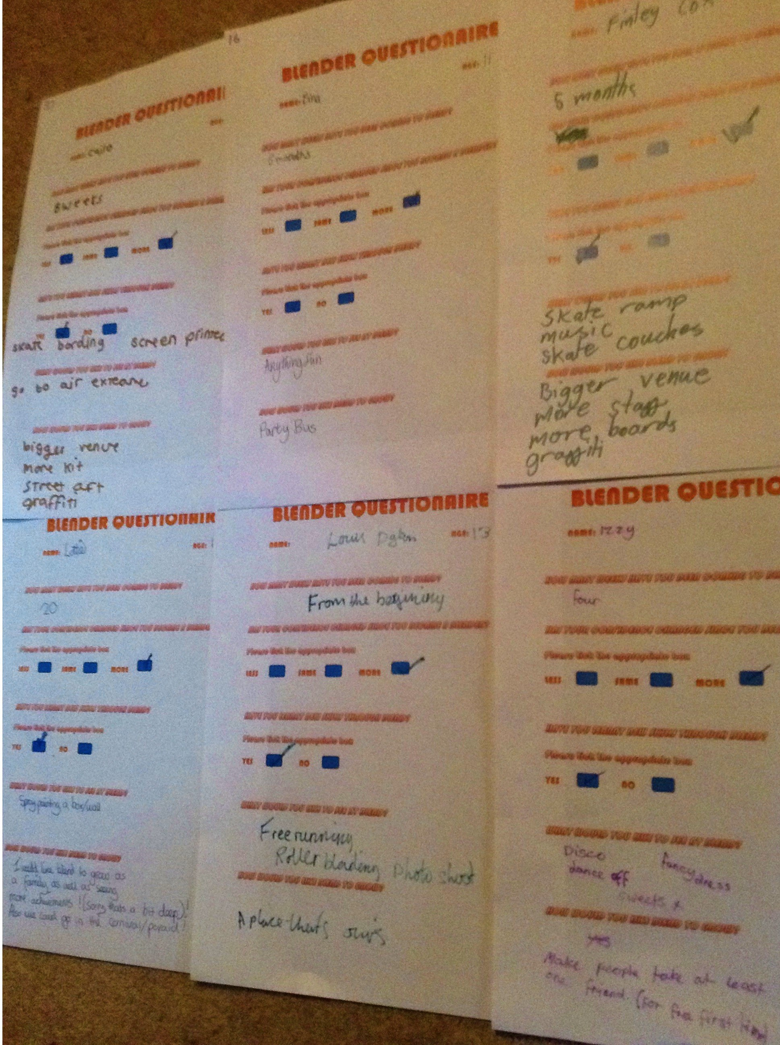
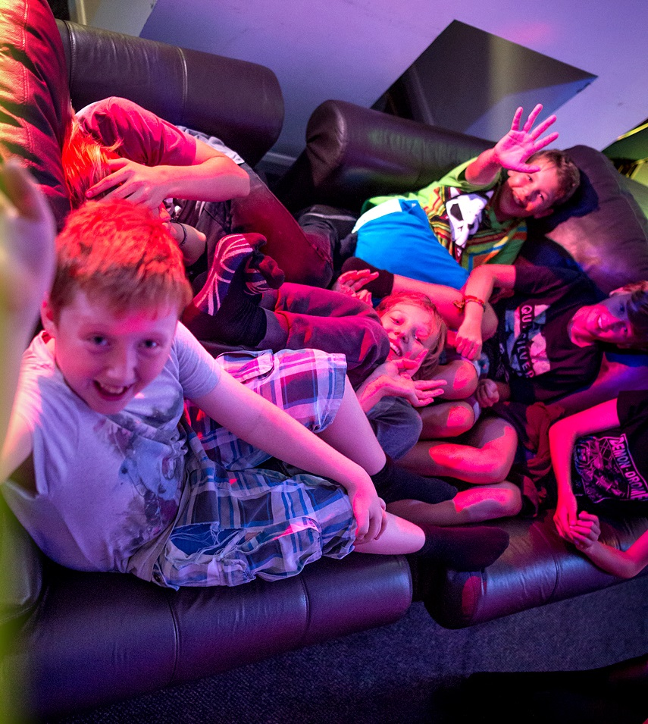
Needs of the youth
Over the Past months we have conducted various questionnaires and surveys. To help us gauge what the actual young people would like to have. The answers came back varied, random but yet unified.

Slide 7
HOW WOULD YOU LIKE BLEND TO GROW?
POOL TABLE. A PLACE THAT’S OURS. TAKE A FRIEND TO BLEND. GRAFFITI. MORE ACTIVITIES. MORE PEOPLE. GROW IN CONFIDENCE. MORE SPACE. PARTY BUS. MORE ADULTS. CAMPING. BEACH. PEOPLE. GET BIGGER. BLEND SONG. FUNDRAISING. BEANBAGS. MORE ROOMS. A FAMILY. CARNIVAL. FOOD,FOOD,FOOD! BIGGER VENUE. STREET ART. SKATEBOARDS. CLIMBING WALL. LIBRARY. QUIET SPACE. MILKSHAKES. GYM. MORE BLENDERS!
There are a lot more answers, but such things as QUICKLY, DON’T KNOW and LIKE A VAMPIRE, we left out.
Several of the answers we have already worked on and completed. Beach excursions, camping, baking and building advocates that give the collective that family feel. Other answers are what we’ve based a lot of our ideas around. Blending them together to create the hub of youth involvement that we want to advocate.
All answers are taken from questionnaires done either at Blend or at Bude haven community school. The answers have also been compiled by Blenders.

Slide 8
What would you like to see at blend?
MORE COLOUR. BOUNCY CASTLE. OUTSIDE ACTIVITIES. FREE RUNNING. ROLLER BLADING. WATER PARK. SURFING. DISCO. FANCY DRESS. MORE EQUIPMENT. MINI PIZZAS. HAPPINESS. FOOD! FURNITURE. FILMS. ANYTHING FUN. GRAFFITI. SKATING. CLIMBING. MILKSHAKES. BEANBAGS. NEW PEOPLE. EXPERIENCES. CHALLENGES. ART. SKATE RAMPS. MY FRIENDS.
Again more answers were available but such things as ZOMBIES, DRACULA and MY BED, were left out.
Several of the answers we have already worked on and completed. Beanbags. skateboards. The others we have helped the members realise its up to them to make it happen, bringing friends, creating challenges, making milkshakes! So again getting them to work together to make things happen.
All answers are taken from questionnaires done either at Blend or at Bude haven. The answers have also been compiled by Blenders.

Slide 9
ANSWERS SUMMARISED
SO IN A NUT SHELL, THEY WOULD LIKE:
A BIGGER SPACE TO HOUSE A BIGGER BLEND, SO MORE BLENDERS CAN ENJOY:
MAKING MORE FOOD, DOING MORE ACTIVITIES ON MORE EQUIPMENT. BRINGING THEM CLOSER THROUGH CHALLENGES AND EXPERIENCES.
MAKING IDEAS REALITY THROUGH ART AND CREATIVITY WHILST MAKING MORE FRIENDS.
Its that simple. No bells, no whistles.

Slide 10
How it would look
A large open plan building would be the only way this dream could be built.
This would house a skate bowl, climbing walls, cafe and lounge area, small shop outlet and multi-use space to hold our youth groups and other youth based activities, including Bude beats dance crew, Waveriders surf club and Beat Bus toddler music sessions.
The general look and feel would be of a high end adult venue. Getting as far from the standard model of a youth club as possible. Stylish interiors, décor and furnishings. In doing this we make it a transition hub from child to teen to adult.
There are buildings in the town that are crying out to be developed in to this venture and are major concerns for the general community due to their long term disuse and their ascetic appearance.

Slide 11
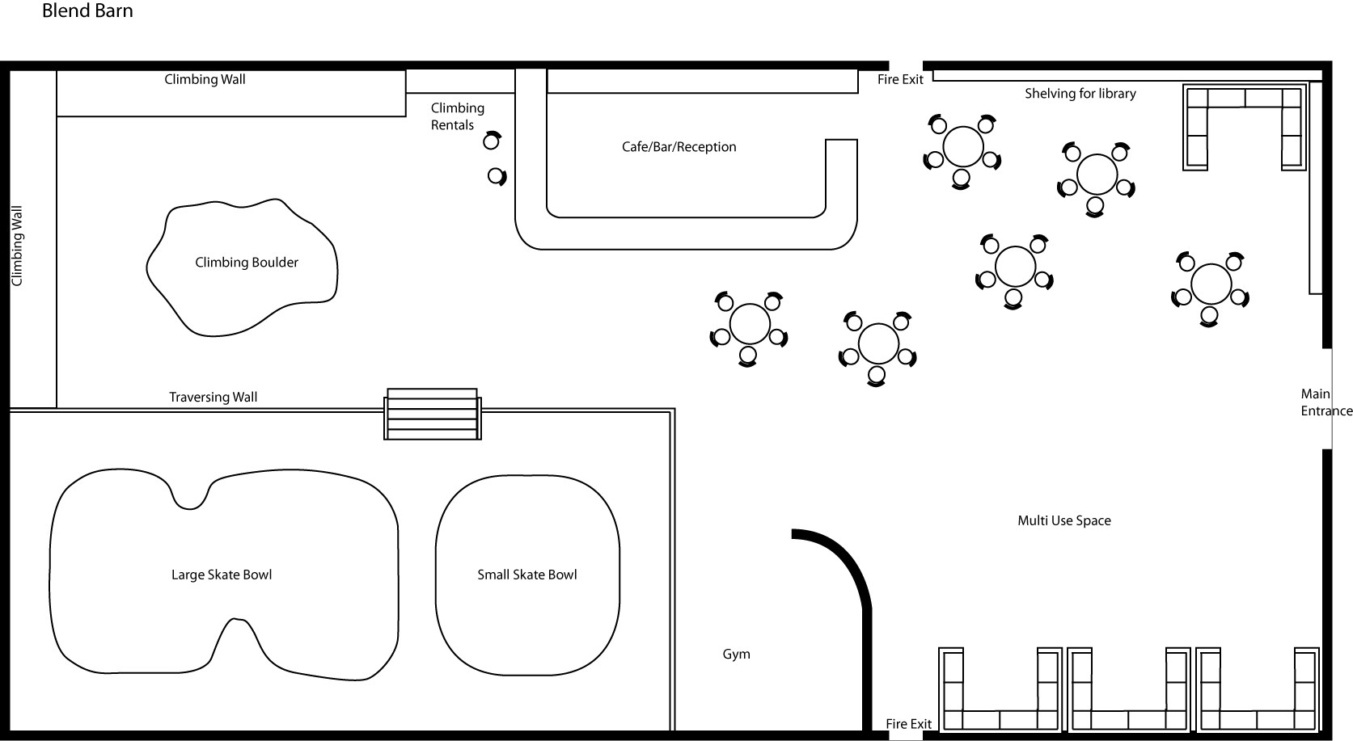
A VISUAL IDEA
All the features are to scale. The layout is only an initial idea. The concept is to give an open, stylish and versatile space that can be adapted to a variety of events and additional future activities.

Slide 12
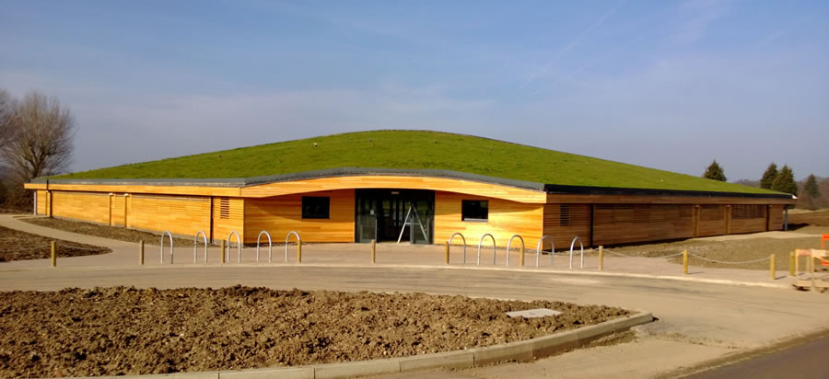
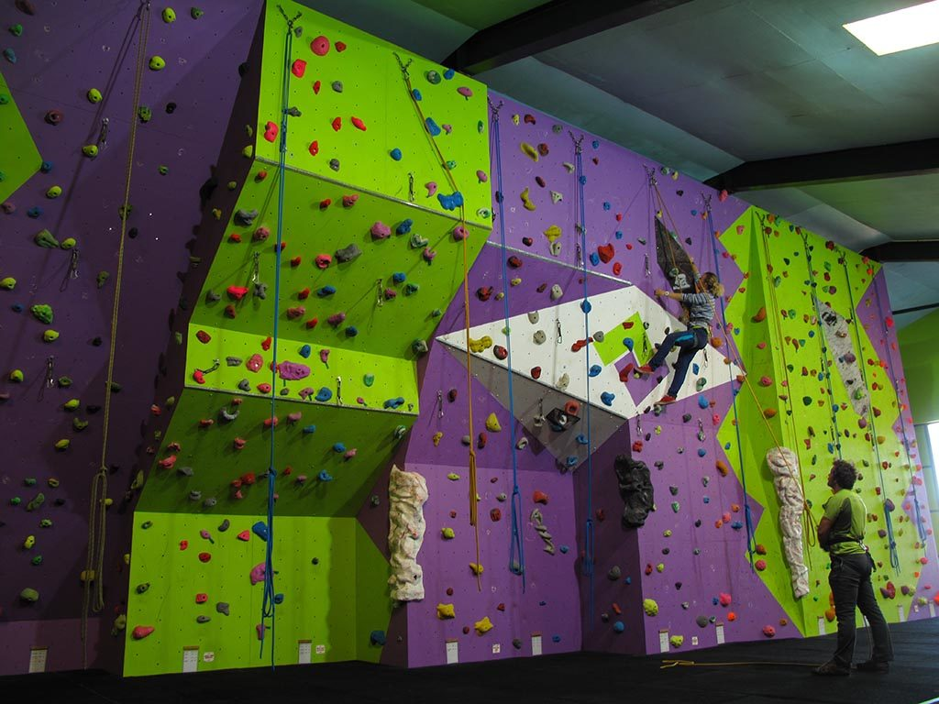
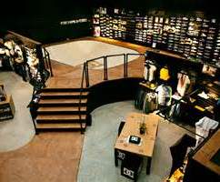
HOW IT COULD LOOK
New build example
Indoor climbing wall
DC showroom. Newquay
A fresh modern design with a considerate finish . A great medium between needs and environmental impact.
A multi purpose, all user friendly climbing wall. This shows how features don’t have to be extreme, giving access to all skills levels.
This is a great example of how the layout of the skate bowls could look at the rear of the building.

Slide 13
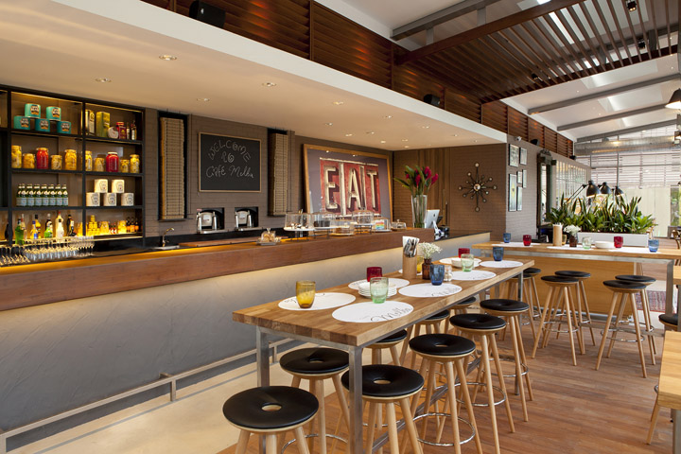
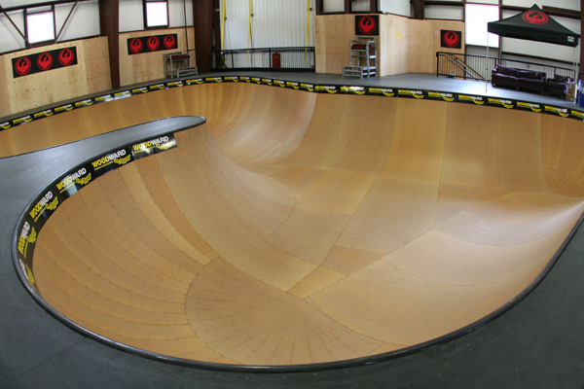
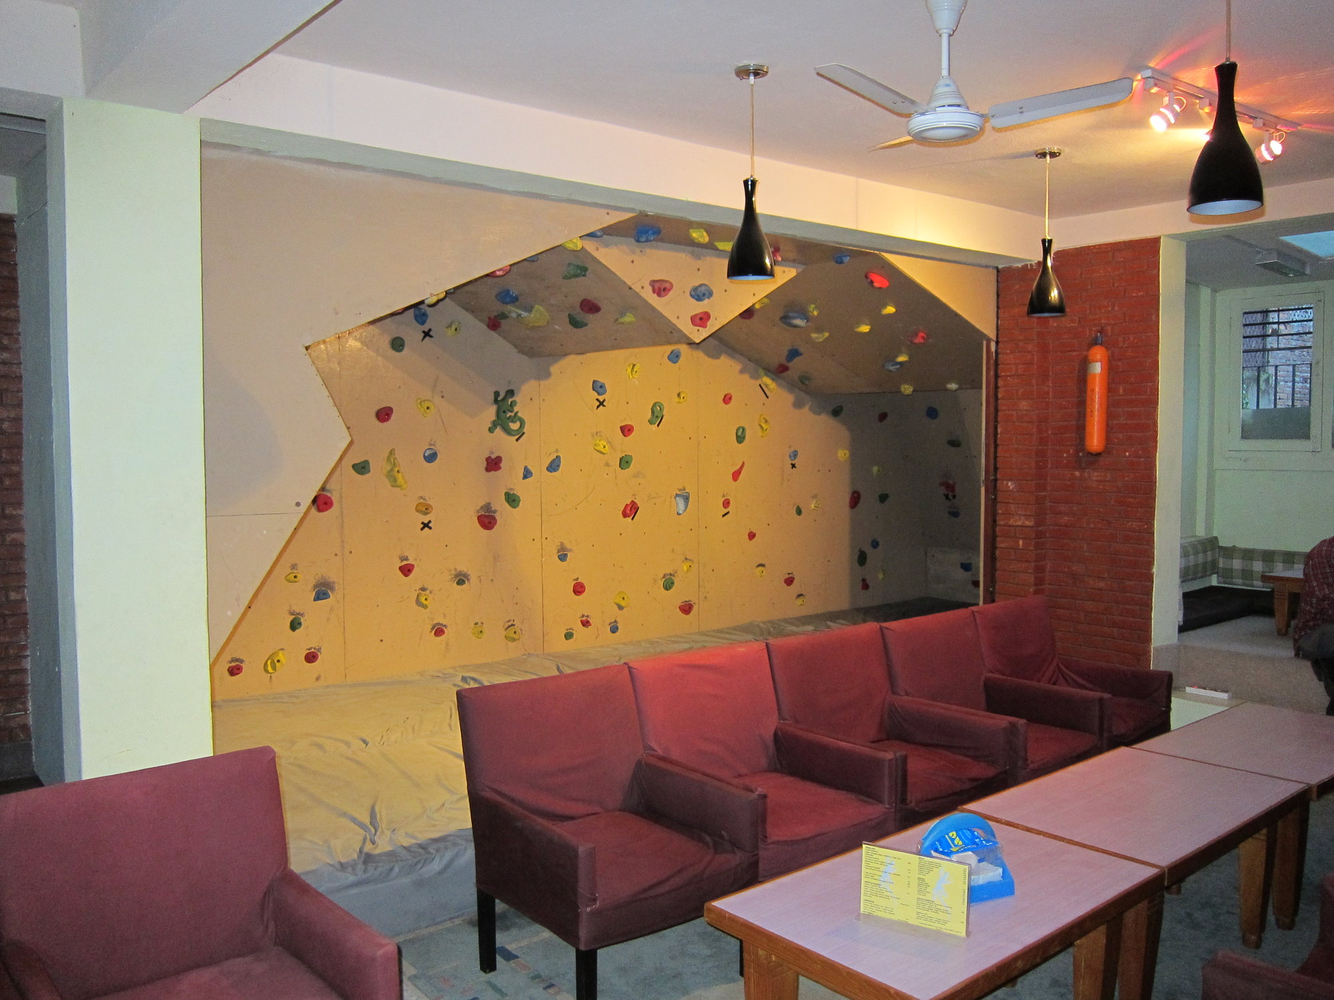
DESIGN EXAMPLES
MILK & JUICE BAR
BESPOKE SKATEBOWLS
BOULDERING HAVENS
Healthy alternative food & drink. Designed, created and served by the youth for the youth. Product pricing, stock management and cash handling would all be supervised by the collective.
Never seen before in Bude. Dynamic designs, put together by the collective and built by professionals. They would then need to manage the usage of this area and come up with innovative ideas to produce profit.
Along with the main climbing walls we would love to have small technical areas for free climbing, that give the attendees a taste of climbing and also ways of expending energy.

Slide 14
THE EFFECTS OF BLENDING BUDE
COGNITIVE BENEFITS
Encourage literal thinking, giving them the ability to make a difference to their own lives.
Promote collective thinking, self confidence and task management.
Allow them to gain knowledge and judgment through self perpetuating life skills
Challenge them to learn organisational skills and take calculated risks.
Challenge them to grow their ideas and to increase their opportunities through the business.

Slide 15
PHYSICAL BENEFITS
Encourage healthy living through sport and preparing and eating healthy foods.
Promote exercise with an unregimented approach. Working to grow their own ability for self improvement not competitive gain.
Allow self learning, but also coaching from capable collective members themselves.
Give them the ability to organise and partake in excursions and outdoor events.

Slide 16
EMOTIONAL BENEFITS
Allow them to express themselves and work with one another to bring their opinions together.
Promote active creativity. Plan adventures, organise excursions. Building a collective through working together to create experiences.
Learn to deal with ambivalent situations and understand the importance of overcoming personal boundaries.
Nurture expression and grow their imaginations through actioning their own ideas.

Slide 17
SOCIAL BENEFITS
Increase confidence, self worth and self esteem.
Encourage the breaking of social stereotypes and the building of friendships.
Give the opportunity to improve social skills, group interaction and improve communication with others.
Provide actual experiences like, promoting, campaigning, interviews and dealing with impromptu situations.
Develop connections with other areas of the community through increased social activities and assistance initiatives.

Slide 18
How this will work
This project would give a hub to the youth of Bude. A company run by the youth collective for the youth of Bude. Giving them a purpose and place to thrive and grow. Whilst learning how a business is run and how they can work together to make it grow.
We as a community interest company would raise funding for the redevelopment, construction or renovation of the building and the construction of the main venture structures.
We have already begun to build a support team of local tradesmen and merchants who would be happy to rally to our cause. Effectively creating a ‘DIY SOS’ style work force to assist in making this vision a reality.
It would then become a self sustaining venture. Each area of the business generating its own income. Supervised by a small team of Blenders who devise the way profits can be increased and new ideas can be realised. All this would benefit the whole of Bude and Stratton youth. They will learn, see and realise that their small fee for using the different amenities with in the building goes towards sustaining the business and gaining the things they would like to see there.

Slide 19
GETTING BLENDING
There are a lot of variables when it comes to start up costs but due to the nature of the vision the initial outlay will be substantial. From redeveloping a derelict cinema, to developing on some old tennis courts or renting a misused hidden gem of a building, they all cost over 80 thousand pounds.
The top end being closer to 3 million. This said, the more plausible ventures are the more realistic figures.
The base elements of the ideal do general stay the same:
Skate bowl: 13-25 thousand pounds.
Climbing walls: 8-12 thousand pounds.
Kitchen and lounge: 8-10 thousand pounds.
There would be costs to incur such as: flooring, lighting, insulation and heating
These would be in the region of: 20-30 thousand pounds.
All the above figures are taken from generalised supplier costings and quotes.
A true costing exercise could only be completed once a property is secured.

Slide 20
the idea of necessity
Through questionnaires, conversations and studies we have highlighted the severe need for the services we have outlined. For too long they have been left to their own devises, left to deal with the transition from childhood to adulthood.
Our base ethos is to give them that haven, somewhere they have confidence in and parents are confident in them being safe. Learning through running the aspects of the business that there ideas can make a difference and that they can make change for themselves.
We would show them the environmental impacts that businesses have on their surroundings and how they can make decisions to effect this. We would allow them to use the lessons they learn at school in a practical and real way, thus showing them that learning does have a purpose. We would want this to grow in to a region wide idea that would be serviced by the original members. Giving them real employment opportunities through the growth of the collective.
Limits are only boundaries we haven’t crossed yet.

Slide 21
THEIR FUTURE.
THEIR BUSINESS.

Slide 22
Run by the youth.
For the youth.

